Slide 1


Car Rental Application Using Java
Paavai Engineering College, Namakkal
Submitted to the Trainer of ByteXL
Submitted by,
Submitted to,
Adhithya S
Pooja Ramaraj
Akash M
The Technical Trainer of ByteXL
Anand R
Sanjith MS

Slide 2

Introduction
The Car Rental System project is a mini-application developed using Java ,Object-Oriented Programming (OOP) principles and DSA core concept.
It aims to simulate the real-world process of renting and returning cars through a command-line interface.
Users can view available cars, rent them for specific days, and return them later.
The system keeps track of customer information, rental details, and car availability.

Slide 3

Problem Statement
Manual car rental processes are slow and prone to human error
Difficult to keep track of car availability and customer details
No centralized system to manage rentals and returns efficiently
Need for a simple automated solution using core Java and OOP

Slide 4
Technologies Used
Software Requirements
🧠 Java (JDK 8 or above) – Core programming language
📝 Java IDE – IntelliJ IDEA / Eclipse / NetBeans
Hardware Requirements
🖥️ System: Windows / Linux / macOS/Android OS

Slide 5
Modules
🔹 Class: Car
• calculatePrice(int days): Calculates total rental price.
• rent() / returnCar(): Update car's availability.
• toString(): Displays car details neatly.
🔹 Class: Customer
• Stores customer ID and name.
• toString(): Displays customer info.
🔹 Class: Rental
• Stores rental info like car, customer, days, and date.
• toString(): Prints rental summary.
🔹 Class: CarRentalSystem
• addCar() / addCustomer(): Add new entries.
• rentCar() / returnCar(): Rent or return logic.
• displayAvailableCars() / searchCar(): Show or search cars.
• viewRentalHistory(): Show past rentals.
🔹 Class: Main
• Entry point. Adds cars and starts the menu.

Slide 6
📊 DSA Concepts Used
✅ 1. ArrayList
• Used to store cars, customers, and rental history.
• Dynamic resizing helps manage runtime data without fixed limits.
✅ 2. Searching
• Linear Search used for finding customers, cars, and models.
✅ 3. Loops & Conditionals
• for loops to iterate through lists.
• if conditions for availability checks and choices.
✅ 4. Encapsulation & OOP
• private fields, public getters/setters for modularity.
✅ 5. Date Handling
• Java Date class used to record rental time.

Slide 7

System Flow
🧍 → Enters Name → ✅ Becomes Customer ↓ Views Available Cars ↓ 🔑 Enters Car ID & Days → 💰 Calculates Price ↓ 📦 Rents Car → 📆 Adds to History ↓ 🔁 Can Return Car

Slide 8
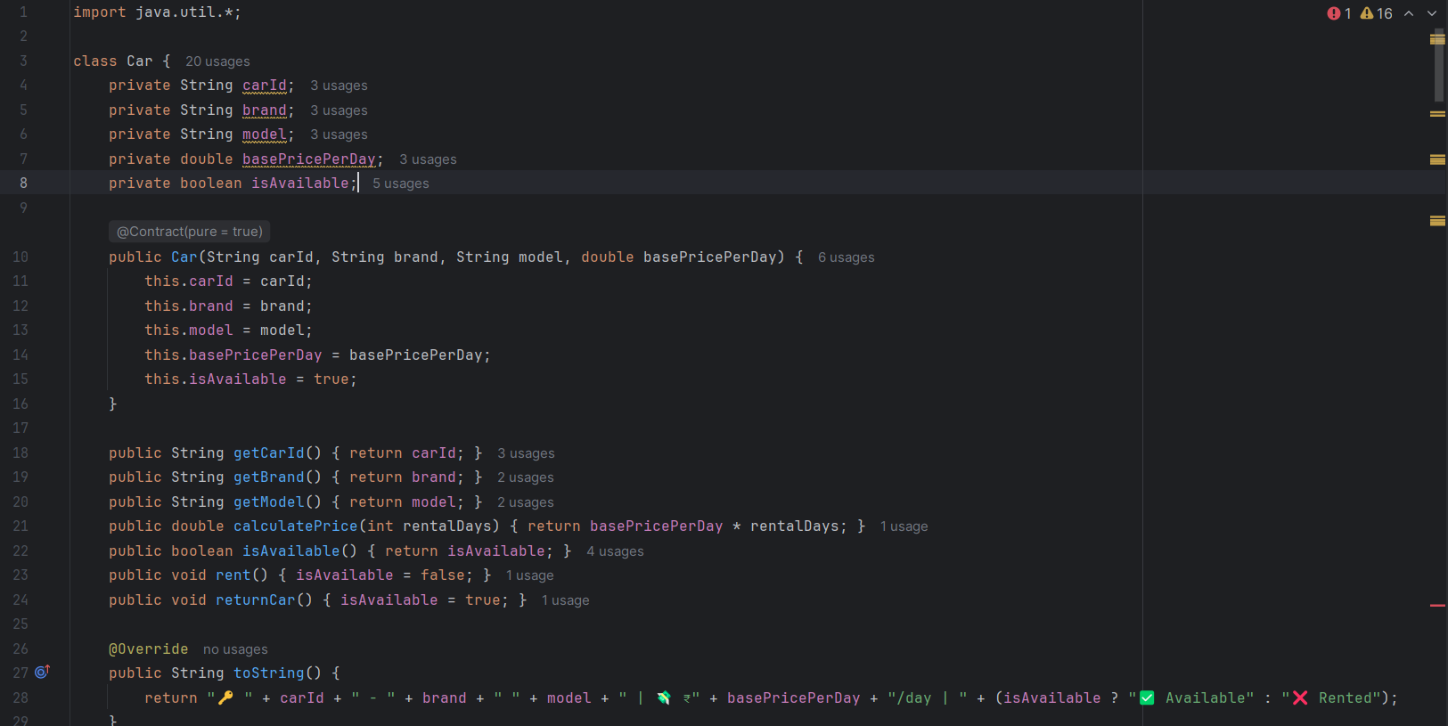
Program

Slide 9
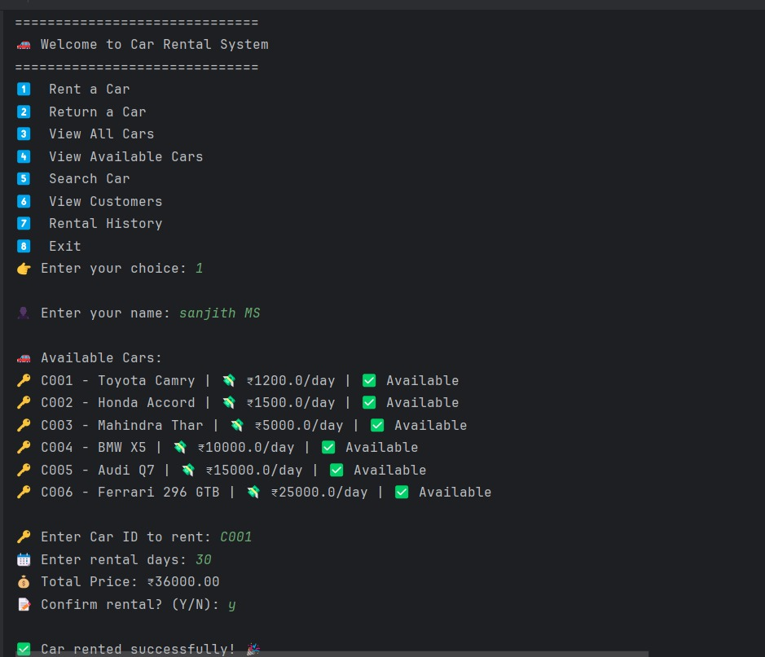
Input &
Output

Slide 10
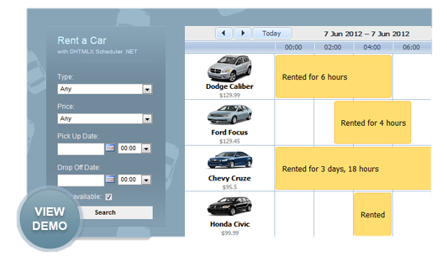

Slide 11

Advantages
✅Simple and easy to use
✅ Good use of OOP concepts
✅ Tracks rentals and customers efficiently
✅ Easy to extend or upgrade
✅ Realistic features like price calculation and car search

Slide 12
Disadvantages
⚠️No GUI – only text-based
⚠️ Data is lost when program exits (no file/database storage)
⚠️ Can’t handle multiple users at the same time
⚠️ No authentication or security features

Slide 13

Conclusions
The system provides a basic and functional car rental platform using core Java.
It demonstrates the use of OOP and DSA in solving real-world problems.
Helps users easily rent, return, and manage cars and customer data.
Can be enhanced further with GUI, database integration, and login systems.

Slide 14
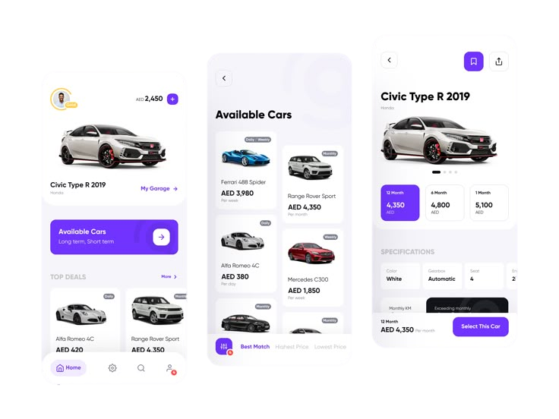
Thank
You

